Slide 1
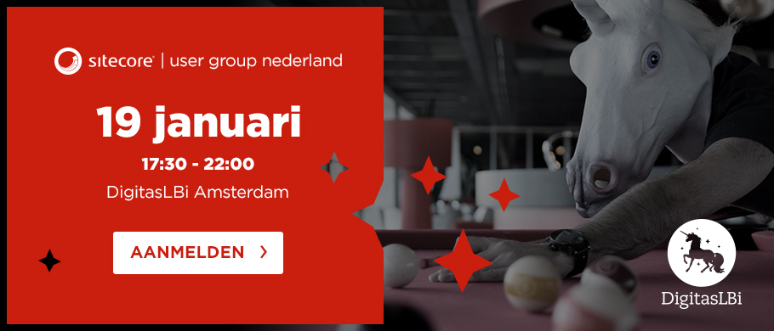
SUGNL Meeting DigitasLBi

Slide 2
Happy new year!

Slide 3
Agenda
17.30 - 18.15 Dinner & Drinks
18.15 - 18.30 Opening SUGNL & DigitasLBi
18:30 - 19:15 Using distributed SOLR indices in a Sitecore project - Lilia Silvastrova (DigitasLBi)
19:15 - 19:30 Break
19:30 - 20:15 Sitecore Q&A a la carte – Alex van Wolferen (Suneco)
20.15 - 20.30 Break
20:30 - 21:15 How we do it: Information Architecture in the Helix Era – Erwin Rijss (Macaw)
21.15 - 21.20 Closing & Questions
21.20 - 22.00 Drinks

Slide 4
Next meetings
February 15th 2017 – Aviva Solutions (Koudekerk a/d Rijn)
Tahzoo, Avanade, Estate, Macaw, Suneco, Achmea
Want to present / Have something cool? Let us know!

Slide 5
SUGCON Europe 2017!
18th & 19th May
Amsterdam
http://www.sugcon.eu/
#SUGCON

Slide 6
Thank you DigitasLBi

